Slide 1
Inheritance and the GUI
Objectives: be able to
Create and display a customised window by writing a subclass of the JFrame class
Set the size, location and title of the window
Identify other methods which can be used with a JFrame from the documentation, including inherited methods
Specify the action to be taken on closing the window by defining an inner class which extends WindowAdapter
List some of the methods in the interface WindowListener
Explain the term ‘event-driven programming’
Give examples of inheritance from the GUI hierarchy in the API

Slide 2
Sample Programs
ClosingWindow1,2,3 & SimplestWindow
API class JFrame
API class WindowAdapter
API class WindowEvent
API interface WindowListener

Slide 3
Textbook sections
Horstmann Chapter 10

Slide 4
Graphical User Interfaces (GUIs)
Until now all programs written are characterised by the fact that the program controls the user’s activities. The program asks for data (or simply uses “hard-coded” data) in a specific order and the user has to input the data or s/he gets no further in the program
With GUIs the situation is radically different: the user of the program is in control. The user can choose the order of the activities and how they will be performed (keyboard or mouse). This is known as event-driven programming.

Slide 5
Event-driven programming
GUI programming builds on a technique called event-driven programming. The program is guided by events that the user initiates either via the keyboard or via the mouse e.g. clicking a button on the GUI or selecting a pull-down menu from the GUI.
GUIs can be created via the Java “Swing” library which houses all the GUI “J” classes

Slide 6
Exercise
What does the acronym GUI stand for?
Explain the difference between a program with a GUI and a program using only the console
What is meant by event-driven programming?

Slide 7
GUIs and Inheritance
The GUI classes in the Java API make extensive use of inheritance. Run the class SimpleWindow1, which inherits from JFrame
A JFrame ‘is a’ Frame, with ‘swing’ bits added
a Frame is a Window with title bar and icons
a Window is a Container which can be iconified or closed
A Container is a Component to which things can be added
A Component is an Object which can be seen

Slide 8
java docs show inheritance
Exercise: open the java documentation, find the class JFrame, and examine its inheritance hierarchy. Note the lists of methods a JFrame inherits from classes further up the hierarchy.
Do the same for JButton

Slide 9
Part of the GUI hierarchy
Object
Component
Container
Panel
Applet
JComponent
JApplet
Color
Font
JComboBox
JTextComponent
JPanel
JLabel
JList
JTextField
JTextArea
JMenuBar
AbstractButton
JPane
JPopupMenu
JToggleButton
JButton
JMenuItem
JScrollbar
JScrollPane
JCheckBox
JRadioButton
JTable
JRadioButtonMenuItem
JCheckBoxMenuItem
JMenu
JTree

Slide 10
More “Is-a” Relationships
JButtons and JMenuItems have the same ancestors:
A JButton is an AbstractButton
An AbstractButton is a JComponent
a JComponent is a Container
A Container is a Component
A Component is …

Slide 11
Notice that the Component class (part of java.awt package) is superclass for all GUI components.
Notice also that the JComponent class (part of javax.swing package) is superclass for most Swing GUI components.
http://www.youtube.com/watch?v=AycnJ-WTX4Y

Slide 12
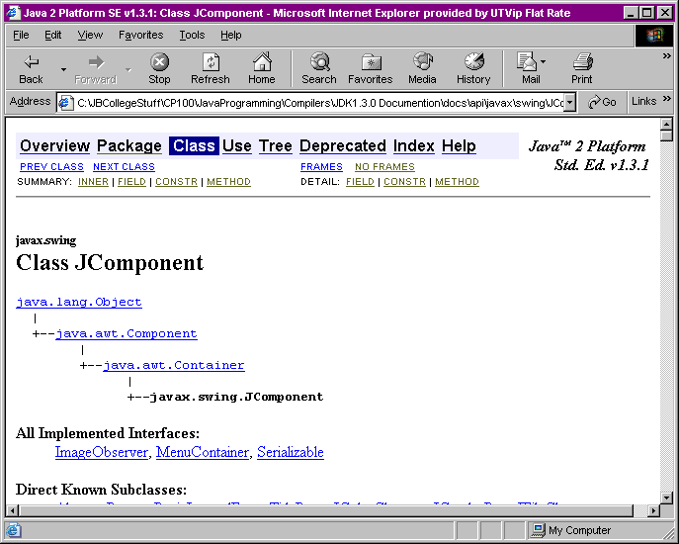
Package Name
Class Name
Where this class fits in the inheritance hierarchy

Slide 13
Some of the Key methods of class Component
public void repaint () -
this method repaints the component
public void requestFocus () -
this method gives the component the focus
public void setBackground(Color newColor) -
public void setForeground(Color newColor) -
public void setFont(Font newFont) –
public Container getParent () -
this method gets a reference to the container that this component is in

Slide 14
Creating your own window: JFrame
JFrame is a Swing component providing the basic attributes and behaviour of a window - a titlebar along with buttons for maximising, minimising and closing the window.
To display a JFrame, we need to construct it, size it and make it visible (UsingObjectDemo0):
public static void main( String args[] ) {
JFrame f1 = new JFrame("First Frame" );
f1.setSize(200,200);
f1.setVisible(true);
} // end main
} // end class UsingObjectsDemo
Slide 14
Notes:
18/10/2013
A nic G OOP2 Slides 4
14

Slide 15
Customising your window: SimplestWindow
To create a more complicated window, we declare a subclass of JFrame and customise it
We still need a main() method which instantiates our subclass, sizes it and makes it visible – this main can be put in a separate class
The customisation is usually done within the subclass constructor, although some can be done in main()
SimplestWindow is a subclass of JFrame with its own location and title
Slide 15
Notes:
18/10/2013
A nic G OOP2 Slides 4
15

Slide 16
main() method for testing SimplestWindow
import javax.swing.*;
public class SimplestWindow extends JFrame {
public static void main (String args[]) {
SimplestWindow win = new SimplestWindow();
win.setSize( 300,200);
win.setVisible(true);
}
Slide 16
Notes:
18/10/2013
A nic G OOP2 Slides 4
16
A subclass of any class is declared by including the keyword 'extends' the class definition header. The example here defines a subclass of JFrame named Ch7JFrameSubclass1.

Slide 17
The role of main()
SimplestWindow is an instantiable class
The driver is inside the instantiable class
This is often done in order to reduce the number of classes in a system
It could be taken out and put in a separate application class
All the driver has to do is to create and display the GUI frame: the GUI then waits for the user to test the system by generating events (clicking, dragging, selecting etc)

Slide 18
Lab Exercise
Go back to your Person and PersonTest classes. Comment out the main() method in PersonTest. Paste a copy of it into Person, making sure it is not within any other method. Recompile both classes, and try to run them. Which of them runs now?

Slide 19
Window size and visibility
The SimplestWindow constructor makes a call to the setSize() method passing two ints as arguments. These ints specify the dimensions of the window in pixels (275 in width, 170 in height). Note that this method must be called since by default the window pane has a size of 0 x 0 pixels (i.e. cannot be seen).
main() creates the window, then calls the setVisible(true) method which is used to display the window on the screen. This method must be called: the window will not be shown by default. The call can be done in main(), or within the constructor

Slide 20
Customizing SimplestWindow
An instance of SimplestWindow will have the following default characteristics:
The title is set to My Window.
The program terminates when the close box is clicked.
The size of the frame is 300 pixels wide by 200 pixels high.
The top left of the frame is positioned at screen coordinate (150, 250).
These properties are set either inside the constructor or in the main(). The constructor is usually the more appropriate location
Notes:
18/10/2013
A nic G OOP2 Slides 4
20
Open the sample Ch7JFrameSubclass1 class and see how the constructor includes a number of statements such as setTitle and setLocation to set the properties. These methods are all inherited from the superclass JFrame. The last statement is setDefaultCloseOperation that defines the frame's behavior when the close box of the frame is clicked. Passing the class constant EXIT_ON_CLOSE specifies to stop the application when the close box of a frame is clicked. Remove this statement and see what happens.

Slide 21
SimplestWindow constructor
Slide 21
import javax.swing.*;
public class SimplestWindow extends JFrame {
public SimplestWindow( ) {
//set the frame default properties
setTitle ( "My Window" );
setSize ( 300,200 );
setLocation ( 150,250 );
//register 'Exit upon closing' as close operation
// since Java 1.5 the default is DISPOSE_ON_CLOSE
setDefaultCloseOperation( EXIT_ON_CLOSE );
}
}
Notes:
18/10/2013
A nic G OOP2 Slides 4
21

Slide 22
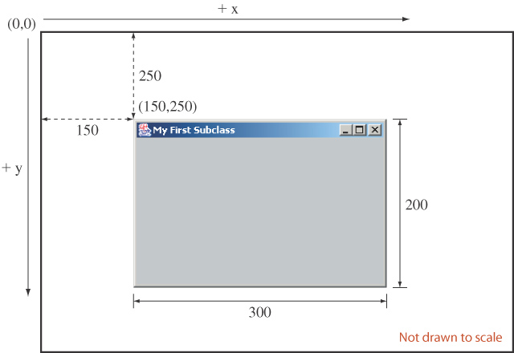
Displaying SimplestWindow
Slide 22
Notes:
18/10/2013
A nic G OOP2 Slides 4
22
This diagram illustrates how the arguments to the setSize and setLocation methods affect the frame window appearance on the screen. The top left corner of the screen has coordinate (0,0). The value of x increases as you move toward right and the value of y increases as you move down. Notice that the screen coordinate is different from the coordinate system of a mathematical 2-D graph.

Slide 23
optional: use ‘this’ within the constructor
Slide 23
import javax.swing.*;
public class SimplestWindow extends JFrame {
public SimplestWindow( ) {
//set the frame default properties
this.setTitle ( "My Window" );
this.setSize ( 300,200 );
this.setLocation ( 150,250 );
//register 'Exit upon closing' as close operation
// this is the default since Java 1.5, so not actually needed
this.setDefaultCloseOperation( JFrame.EXIT_ON_CLOSE );
}
}
Notes:
18/10/2013
A nic G OOP2 Slides 4
23

Slide 24
Contrast with main() method
(Remember that main need not be in the same class)
import javax.swing.*;
public class SimplestWindowTest {
public static void main (String args[]) {
SimplestWindow win = new SimplestWindow();
win.setSize( 300,200);
win.setVisible(true);
} // end main()
} // end class
Slide 24
Notes:
18/10/2013
A nic G OOP2 Slides 4
24
A subclass of any class is declared by including the keyword 'extends' the class definition header. The example here defines a subclass of JFrame named Ch7JFrameSubclass1.

Slide 25
Desk Exercise
What are the two things that mark a method as a constructor method for a class?
Lab Exercise
Locate in the documentation a method which will allow you to display an icon on the JFrame title bar: work out how to use it, and add an icon to your window. Note that to construct an Image from a file:
Image i = Toolkit.getDefaultToolkit()
.getImage(“filename.gif”);
Or
Image i = new ImageIcon("travelbug.gif").
getImage());
For Image you need to import java.awt.*

Slide 26
Note on Image and ImageIcon
Image is a ‘old’ class: constructing images is complicated
ImageIcon is a ‘new’ one: it’s easy:
ImageIcon myIcon = new ImageIcon(“filename.gif”);
You can convert an ImageIcon to an Image by:
myIcon.getImage()
Check the headers of methods to see which is required

Slide 27
Handling WindowEvents: ClosingWindow1
ClosingWindow1 is a subclass of JFrame which handles clicks on the ‘close’ icon using a subclass of WindowAdapter. It generates a customised message when you close the window.
See the documentation for JFrame and WindowAdapter
Slide 27
Notes:
18/10/2013
A nic G OOP2 Slides 4
27

Slide 28
import javax.swing.*;
import java.awt.event.*;
public class ClosingWindow1 extends JFrame {
// driver
public static void main(String args[]){
ClosingWindow1 win = new SimpleWindow1();
win.setVisible(true);
}
// constructor
public ClosingWindow1(){
super("This is a JFrame window");
setSize(275,170);
setLocation(250,200);
addWindowListener(new WindowEventHandler());
}

Slide 29
Inner class to handle window events
private class WindowEventHandler extends WindowAdapter {
public void windowClosing(WindowEvent e)
{
System.out.println("Test message to console");
System.exit(0);
} // end method windowClosing()
} // end class WindowEventHandler
} // end class ClosingWindow1

Slide 30
Analysis of Program
Note the imports:
java.awt.event (needed for event handling class WindowAdapter) and
javax.swing (needed for the JFrame class itself)
We create a subclass of JFrame (called ClosingWindow1) and define a constructor for this subclass.
This constructor then calls its superclass (JFrame) constructor via the super keyword, passing it some text for the title bar.

Slide 31
Handling window events
The constructor makes a call to the addWindowListener() method. The reason for doing this is to ensure that there is some object in the system capable of “listening” to events that occur on our window and handling those events.
These might be events such as clicking on the window, moving the window, resizing the window, minimising or even closing (exiting) it.
In our case the object capable of listening to such events is a WindowEventHandler object that we define especially for the task.

Slide 32
The WindowEventHandler Class
This is defined as a private “inner” class, part of the ClosingWindow1 class definition itself. This is acceptable since the class is effectively bound to our SimpleWindow1 class and will not be used outside it (its instance will only be concerned with handling events that take place on the window it is defined for).
The WindowEventHandler class inherits from the WindowAdapter class and takes on board all of its methods by default.

Slide 33
Exercise
Investigate the documentation for the WindowAdapter class: identify all the interfaces implemented by it, and identify the one which contains a windowClosing() method.
How many methods are listed in the WindowListener interface?

Slide 34
Adapter classes
The WindowAdapter class contains an implementation (default or empty) for each method in WindowListener
This makes it easy for WindowEventHandler to concentrate on windowClosing() only

Slide 35
We must override the default inherited windowClosing(), if we want something non-standard to happen when we click on the exit button to close the window.
Our program just sends a simple message to the console, then signals the end of the program’s execution, but it could do something more important such as saving the contents of the window to a file
By default (in the absence of this overriding), clicking to close the window will close it but will not cause the program to exit, or display a message. To exit, releasing all resources, we must invoke
System.exit(0);

Slide 36
The role of the ‘0’ in exit(0)
Under certain operating systems, a program can return an int when it exits. The convention is to return ‘0’ for a normal ending, allowing lots of other numbers for different sorts of error-driven ending
eg System.exit(1) if it can’t find a file, System.exit(2) if it finds the file but can’t write to it, etc.

Slide 37
Exercise
Go through the code for ClosingWindow1.java carefully, and find all of the following:
2 objects which are used or mentioned
a method call which takes a boolean argument
a method call which takes 2 int arguments
2 examples of inheritance
2 method definitions

Slide 38
Event-Handling
In GUI systems events are triggered via the mouse or keyboard by the user pressing on a button, or minimising a window etc.
When a window is closed the Java interpreter (behind the scenes) creates an instance of the WindowEvent class, then sends (in our case) windowClosing() messages to the registered listener (WindowEventHandler)
The listener carries out its own version of windowClosing(), not the default action.

Slide 39
Exercise
Open the java documentation and investigate the WindowEvent class: what information does the JVM package into this class?

Slide 40
Interface WindowListener
Classes which take non-standard action in response to WindowEvents must implement WindowListener, and provide versions of each of its 7 methods.
This would be tedious for us, as we are only interested in one of them, windowClosing()
Adapter classes make this easier: they provide default (empty) implementations of all the methods of the interface: we need only over-ride the ones we are interested in

Slide 41
Where to define WindowEventHandler
Defining WindowEventHandler as an inner class of SimpleWindow1 allows it access to all the attributes and methods of SimpleWindow1.
There are 2 other ways to define this class: as an anonymous inner class, or as a totally separate class. The windowClosing event can also be handled internally in SimpleWindow1.

Slide 42
Anonymous Inner Classes
An inner class as we have defined can be very useful when event handling. Note that this class has a class name WindowEventHandler .
Sometimes programmers prefer to use so-called “anonymous” inner classes for event-handling. An anonymous inner class is one without a name and so an object of the class must be created at the point where the class is defined. The following example illustrates an anonymous inner class being used for the previous window example.

Slide 43
/*Shows a window being created via the JFrame Swing component: demonstrates the use of an anonymous inner class for event handling*/
//import statements as before
public class ClosingWindow2 extends JFrame {
public ClosingWindow2()
{
//almost exactly as in previous case //except listener registration absent
}

Slide 44
public static void main(String args[])
{
ClosingWindow2 win = new SimpleWindow2();
win.addWindowListener(new WindowAdapter() {
public void windowClosing(WindowEvent e){
JOptionPane.showMessageDialog(null,”
Closing down”);
System.exit(0);
}
}
);
}
}
Here the class will be a subclass of WindowAdapter
The code in red marks the definition of the anonymous inner class

Slide 45
The program works exactly as before.
Note also that the anonymous inner class definition could have been placed in the ClosingWindow2() constructor instead. Would there have been any changes codewise?
Students usually tend to avoid coding using anonymous inner classes due to their complex looking appearance in a program but you should be able to interpret them should you see them in books, exams or the work of other programmers.

Slide 46
Handling the event internally in ClosingWindow3
ClosingWindow3 handles windowClosing() itself without using a handler class by implementing WindowListener
In this case, we must provide empty versions of the other 6 WindowListener methods (see SimpleWindow3).
This is tedious for an interface with 7 methods, but it is often done for ActionListener which only contains one method, and deals with button clicks and menu selections

Slide 47
Implementing WindowListener
public class ClosingWindow3 extends JFrame implements WindowListener {
..
addWindowListener(this);/
} // end constructor
public void windowClosing(WindowEvent e){
JOptionPane.showMessageDialog(null,
"Closing down");
System.exit(0);
} // end windowClosing

Slide 48
Stubs for other methods of WindowListener
public void windowActivated(WindowEvent e){ }
public void windowClosed(WindowEvent e){ }
public void windowDeactivated(WindowEvent e){ }
public void windowIconified(WindowEvent e){ }
public void windowDeiconified(WindowEvent e){ }
public void windowOpened(WindowEvent e){ }
}// end ClosingWindow3 class

Slide 49
Handling events in a totally separate class
It is possible to create a totally separate public class to handle the window closing event
In this case,
the definition of WindowEventHandler is available for re-use by other classes
the code for ClosingWindow becomes shorter
But it does not ‘see’ the attributes and methods of ClosingWindow by default, so a reference to ClosingWindow must be passed to it, which makes the code of WindowEventHandler more complicated.

Slide 50
Relevant parts of the Java API
The javax.swing.JFrame class
public JFrame()
window with blank title bar
public JFrame(String title)
window with text in title bar
The java.awt.Frame class
superclass of JFrame
public String getTitle()
public void setTitle(String title)
allows a windows title to be retrieved or set

Slide 51
The java.awt.Window class
superclass of Frame
public void addWindowListener(WindowListener wlist)
registers a listener for the window
The java.awt.Component class
superclass of Container
public void setVisible(boolean visible)
allows a window to be shown or hidden
public void setSize(int width,int height)
public void setLocation(int x, int y)

